Slide 1
Solarization
Experimental Photography

Slide 2
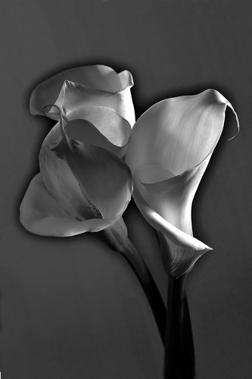
Also Called the Sabatier Effect
Solarization is the process of re-exposing photographic paper during the development process. The result is an eerie silver image which contains light lines between the shadows and the highlighted areas.

Slide 3
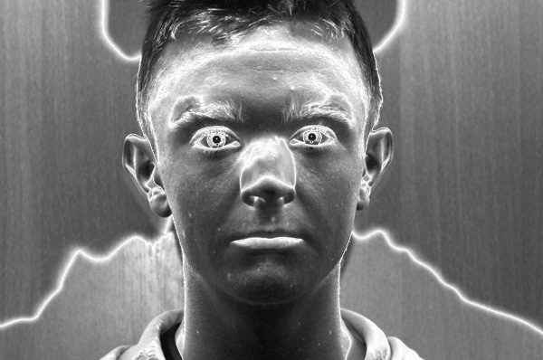
Areas that have been exposed the least are affected the most during the re-exposure of the print. The darker areas or shadows on the prints show little change during the solarization process.

Slide 4
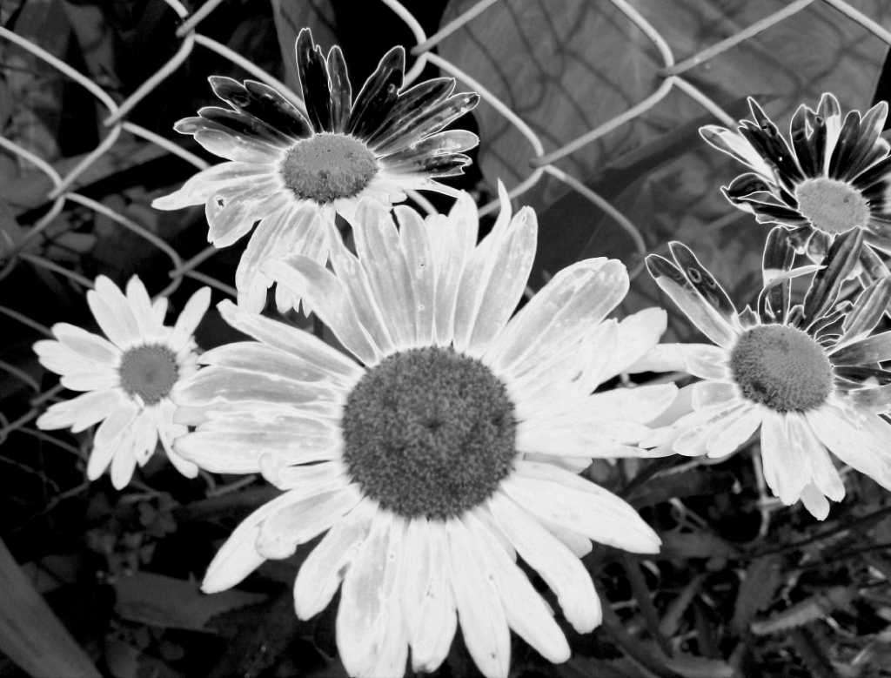
Both photographic film and paper, and both positives and negatives, can be solarized

Slide 5
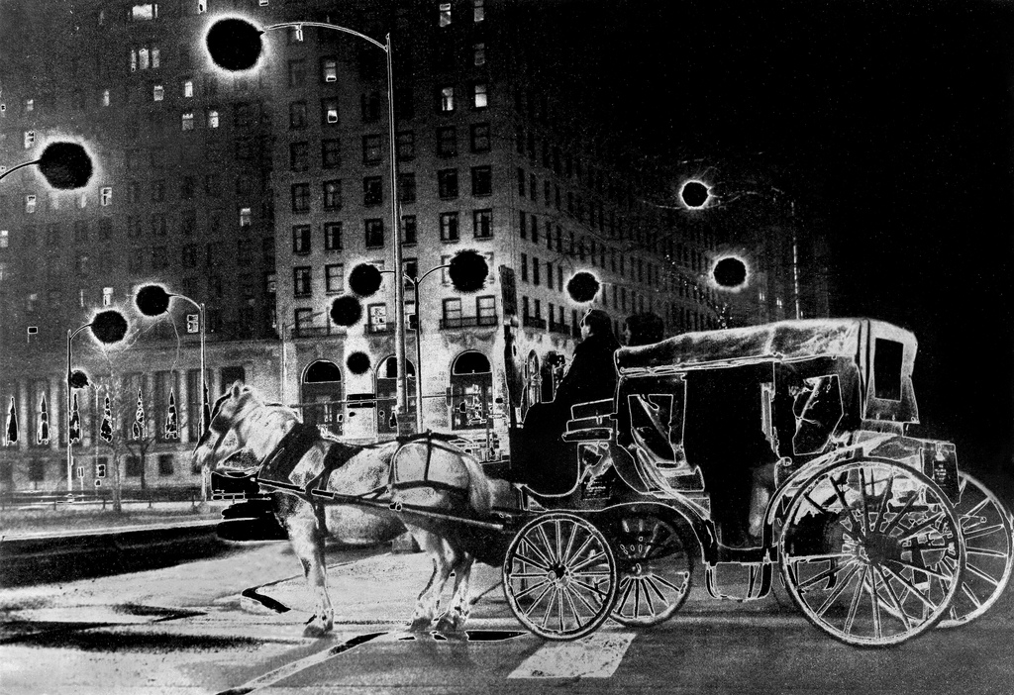
The major observable effects of solarization are a partial reversal of tones (light tones become darker, although dark tones don’t generally get lighter, although they may sometimes look darker because of the darkening of surrounding tones) and the creation of so-called Mackie lines: white outlines at boundaries between areas of different light/dark values

Slide 6
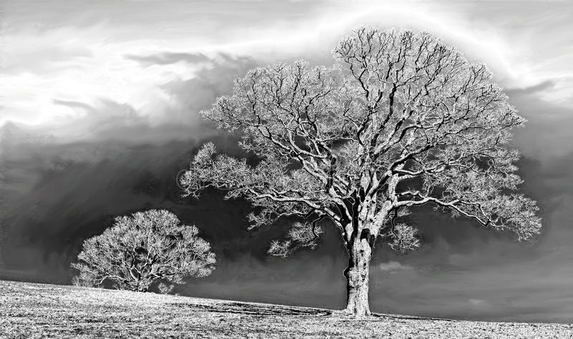
Solarization has many variations, and a wide range of effects can be obtained by varying the first exposure of the photo paper (that is, the exposure made with the negative in place in the enlarger) and the length and intensity of the second “re-exposure” to white light.

Slide 7
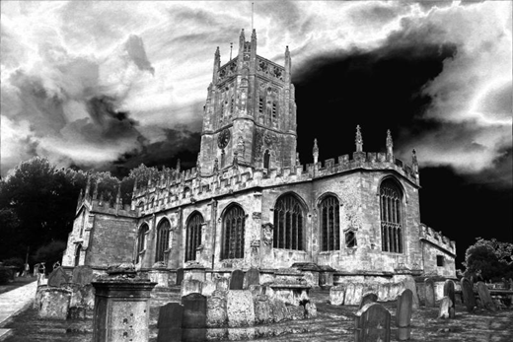
Solarization is a technique which can be applied to any negative in the printing process. In technical terms, it works best with sharp negatives having good contrast; aesthetically, you will have to decide whether the “look” of solarization adds to or detracts from any particular image, and just how much solarization is appropriate.

Slide 8
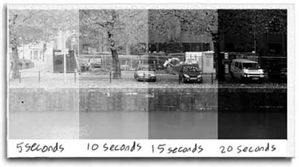
Step 1
Make a Test strip of the image you would like to solarize
Develop test strip and bring into classroom to decide on a development time

Slide 9
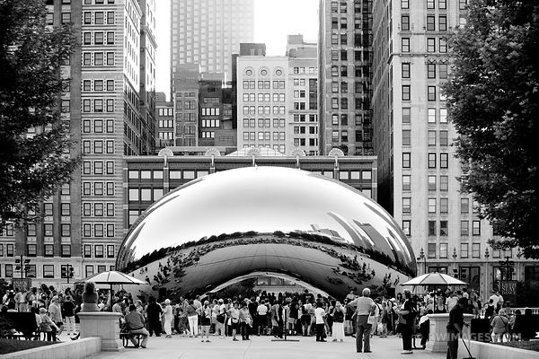
Step 2
Make a 5x 7 print with your chosen time.

Slide 10
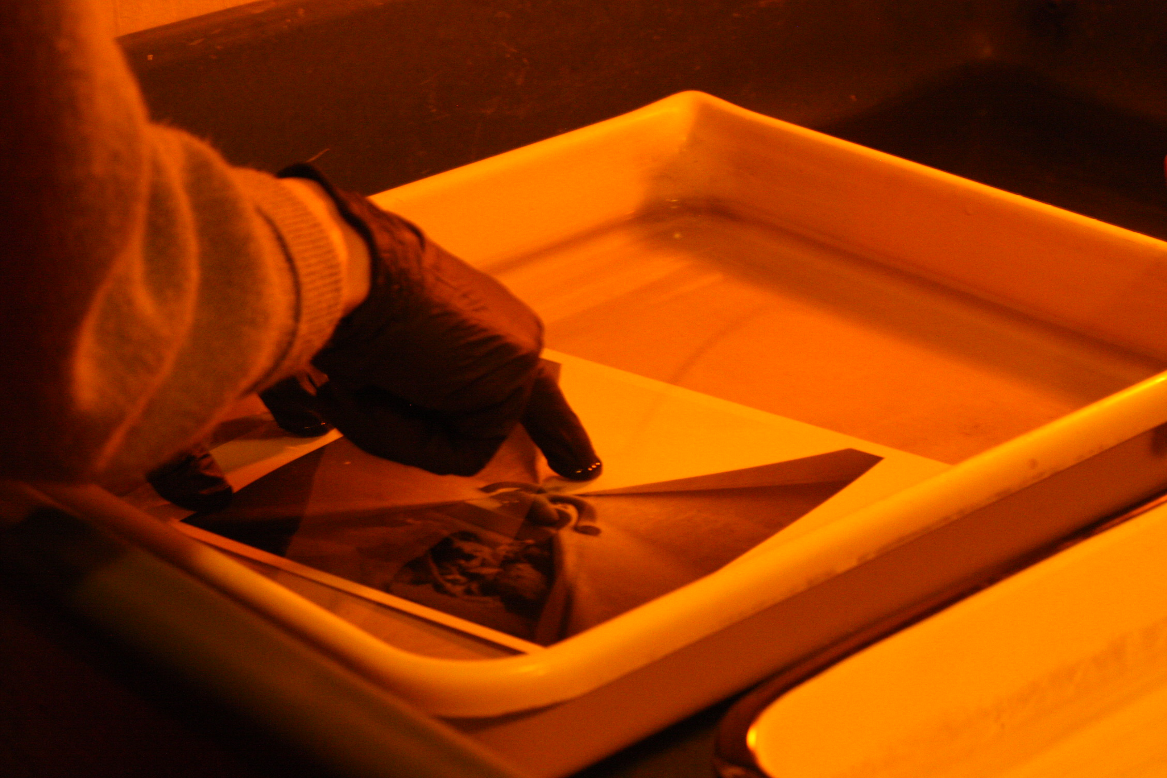
Step 3
Cut a new 5x7 paper and expose paper for desired time based on test strip. Same as original photo.
Place paper in developer for 1 minute

Slide 11
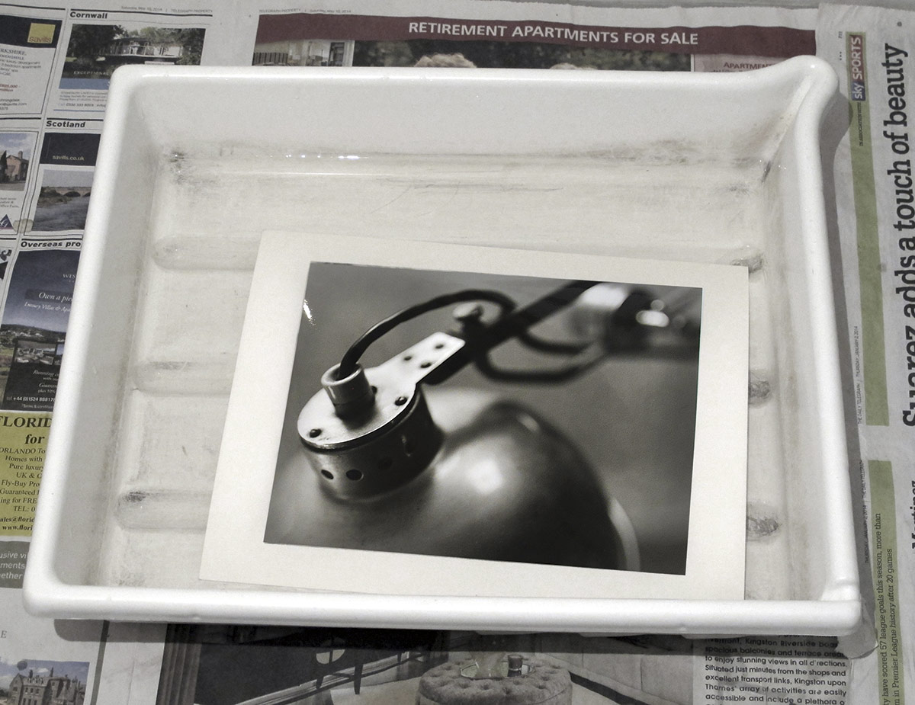
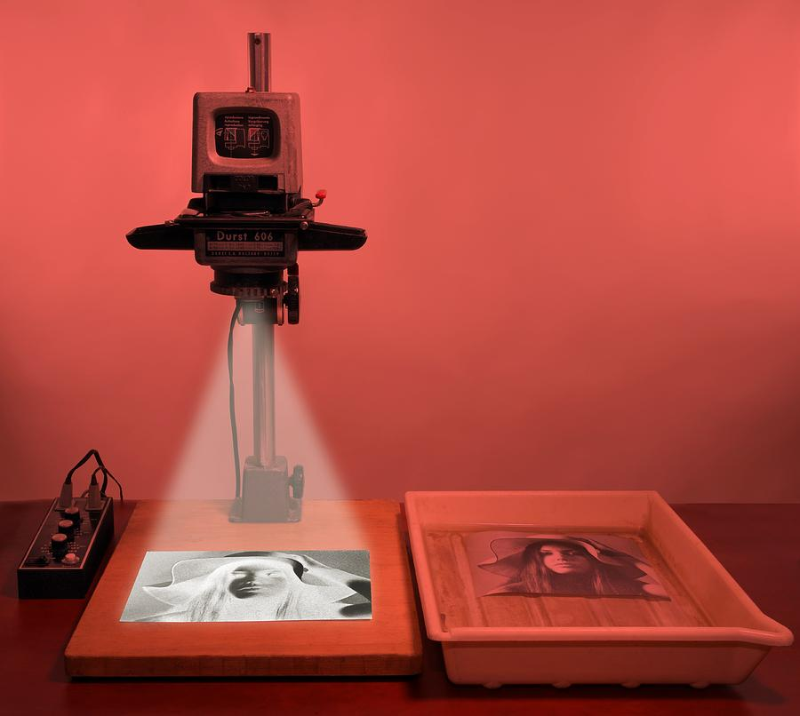
Step 4
Take your photo out of the developer and put it into a tray.
Take your negative carrier out of the enlarger
Set your timer to 1 second
Place your tray with the photo in it on the baseboard and expose the photo for 1 second

Slide 12
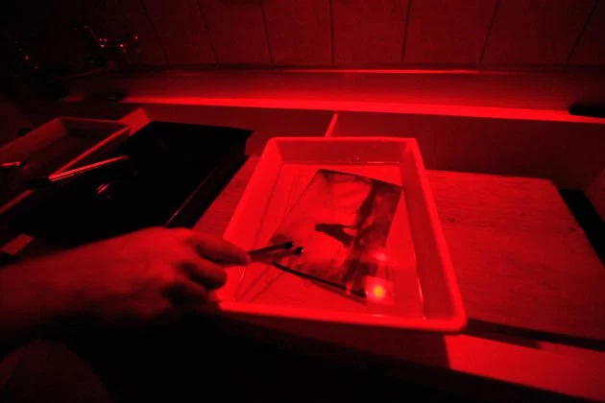
Step 5
Put your photo back in the developer and carry through the rest of the chemical development process as you normally would.

Slide 13
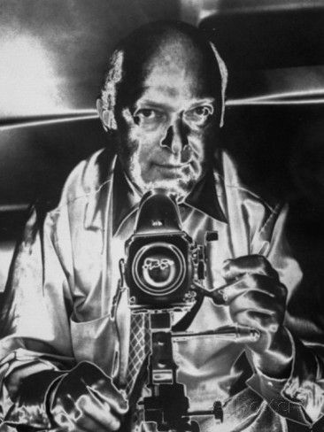
Step 6
Drymount your final photos for grading. Original photo and solarized.

Slide 14
Final Project
Mount the two images together on one board.
Original
Solarized

